Slide 1

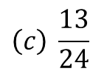
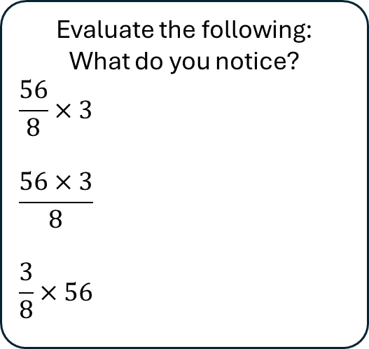
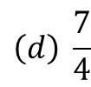
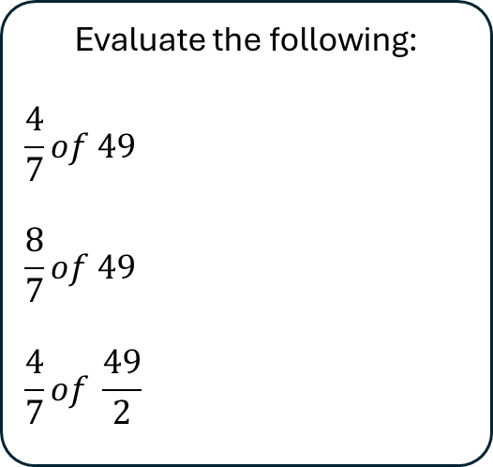
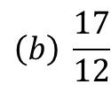
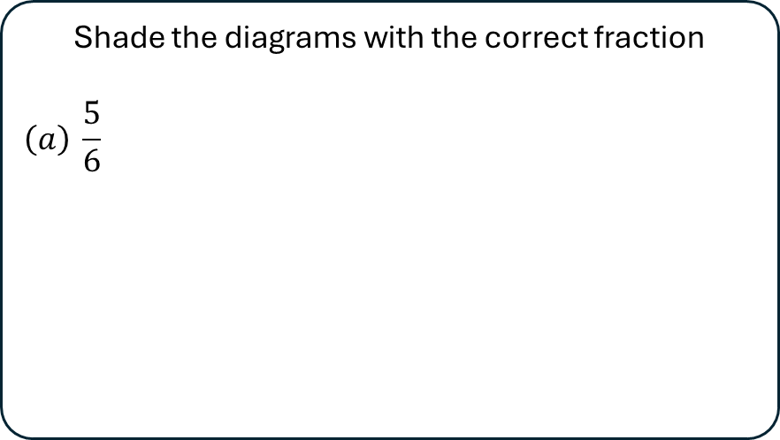
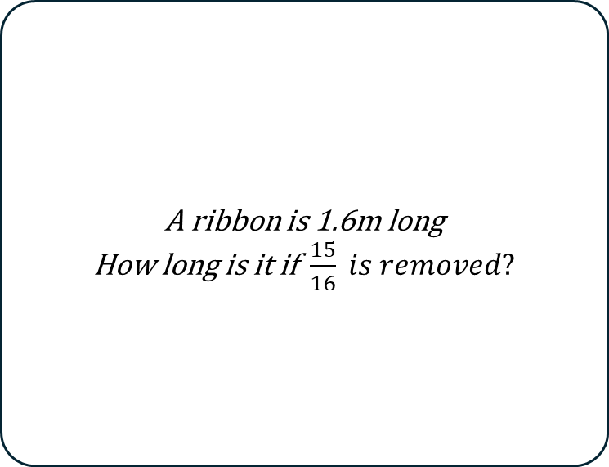
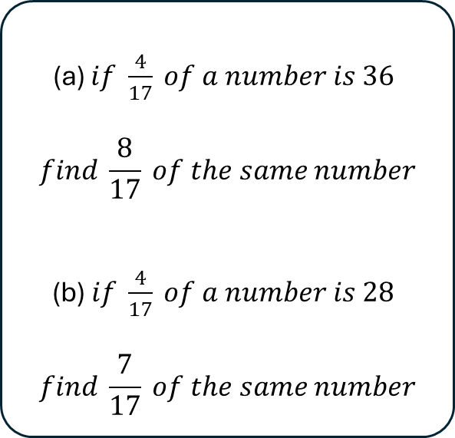
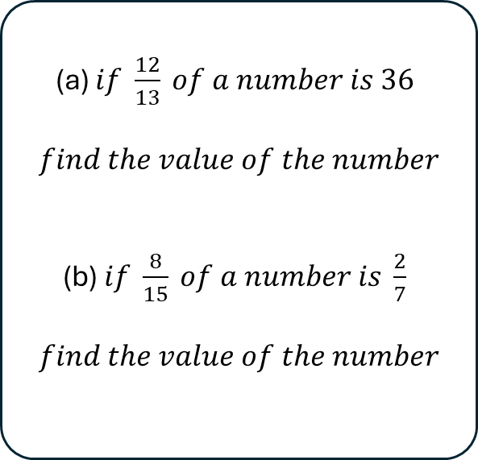
Evaluate the following:
$$\frac{4}{7}of 49$$
$$\frac{8}{7}of 49$$
$$\frac{4}{7}of \frac{49}{2}$$
Evaluate the following:
What do you notice?
$$\frac{56}{8}×3$$
$$\frac{56×3}{8}$$
$$\frac{3}{8}×56$$
Shade the diagrams with the correct fraction
$$\left(a\right) \frac{5}{6}$$
1
2
3
$$\left(b\right) \frac{17}{12}$$
$$\left(c\right) \frac{13}{24}$$
$$\left(d\right) \frac{7}{4}$$
(a) $if \frac{4}{17} of a number is 36$
$$find \frac{8}{17} of the same number$$
(b) $if \frac{4}{17} of a number is 28$
$$find \frac{7}{17} of the same number$$
(a) $if \frac{12}{13} of a number is 36$
$$find the value of the number$$
(b) $if \frac{8}{15} of a number is \frac{2}{7}$
$$find the value of the number$$
A ribbon is 1.6m long
How long is it if $\frac{15}{16} is removed?$
4
5
6

