Slide 1
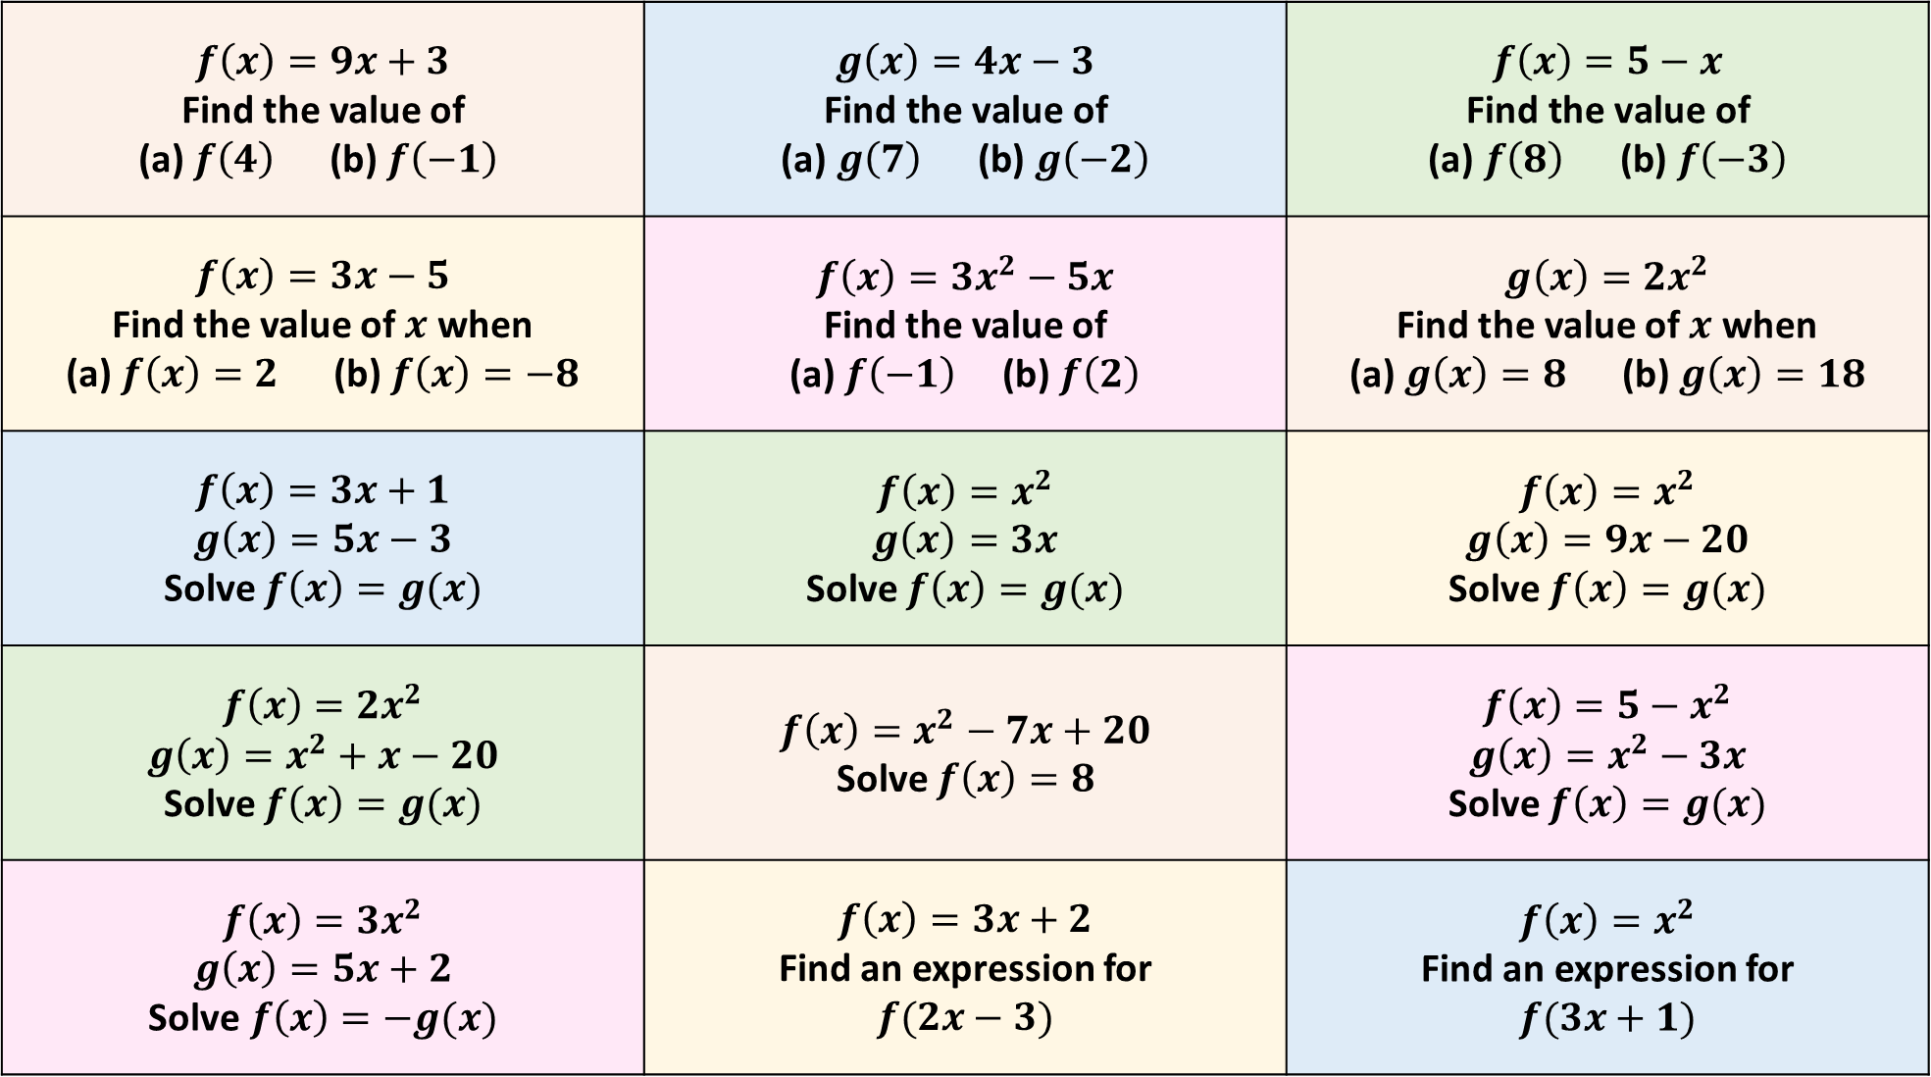
$$f\left(x\right)=9x+3$$ Find the value of (a) $f\left(4\right)$ (b) $f\left(−1\right)$ | $$g\left(x\right)=4x−3$$ $$\text{Find} \text{the} \text{value} \text{of}$$ $$\text{(}\text{a}\text{) }g\left(7\right) \text{ (}\text{b}\text{) }g\left(−2\right)$$ | $$f\left(x\right)=5−x$$ $$\text{Find} \text{the} \text{value} \text{of}$$ $$\text{(}\text{a}\text{) }f\left(8\right) \text{ (}\text{b}\text{) }f\left(−3\right)$$
$$f\left(x\right)=3x−5$$ Find the value of $x$ when (a) $f\left(x\right)=2$ (b) $f\left(x\right)=−8$ | $$f\left(x\right)=3x^{2}−5x$$ Find the value of (a) $f\left(−1\right)$ (b) $f\left(2\right)$ | $$g\left(x\right)={2x}^{2}$$ Find the value of $x$ when (a) $g\left(x\right)=8$ (b) $g\left(x\right)=18$
$$f\left(x\right)=3x+1$$ $$g\left(x\right)=5x−3$$ Solve $f\left(x\right)=g(x)$ | $$f\left(x\right)=x^{2}$$ $$g\left(x\right)=3x$$ Solve $f\left(x\right)=g(x)$ | $$f\left(x\right)=x^{2}$$ $$g\left(x\right)=9x−20$$ Solve $f\left(x\right)=g(x)$
$$f\left(x\right)={2x}^{2}$$ $$g\left(x\right)=x^{2}+x−20$$ Solve $f\left(x\right)=g(x)$ | $$f\left(x\right)=x^{2}−7x+20$$ Solve $f\left(x\right)=8$ | $$f\left(x\right)={5−x}^{2}$$ $$g\left(x\right)=x^{2}−3x$$ Solve $f\left(x\right)=g(x)$
$$f\left(x\right)={3x}^{2}$$ $$g\left(x\right)=5x+2$$ $$\text{Solve} f\left(x\right)=−g(x)$$ | $$f\left(x\right)=3x+2$$ Find an expression for $$f(2x−3)$$ | $$f\left(x\right)=x^{2}$$ Find an expression for $$f(3x+1)$$
1
2
3
4
5
6
7
8
9
10
11
12
13
14
15

Slide 2



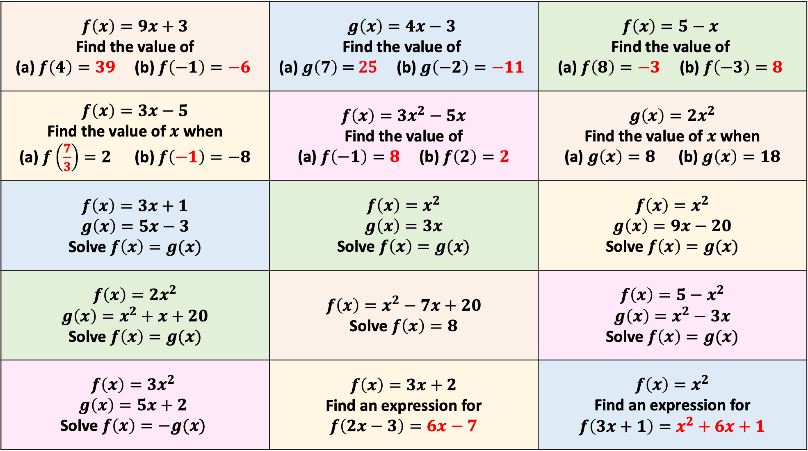


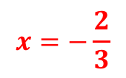









$$f\left(x\right)=9x+3$$ Find the value of (a) $f\left(4\right)=39$ (b) $f\left(−1\right)=−6$ | $$g\left(x\right)=4x−3$$ $$\text{Find} \text{the} \text{value} \text{of}$$ $$\text{(}\text{a}\text{) }g\left(7\right) \text{= }\text{25}\text{ (}\text{b}\text{) }g\left(−2\right)=−11$$ | $$f\left(x\right)=5−x$$ $$\text{Find} \text{the} \text{value} \text{of}$$ $$\text{(}\text{a}\text{) }f\left(8\right)=−3 \text{(}\text{b}\text{) }f\left(−3\right)=8$$
$$f\left(x\right)=3x−5$$ Find the value of $x$ when (a) $f\left(\frac{7}{3}\right)=2$ (b) $f\left(−1\right)=−8$ | $$f\left(x\right)=3x^{2}−5x$$ Find the value of (a) $f\left(−1\right)=8$ (b) $f\left(2\right)=2$ | $$g\left(x\right)={2x}^{2}$$ Find the value of $x$ when (a) $g\left(x\right)=8$ (b) $g\left(x\right)=18$
$$f\left(x\right)=3x+1$$ $$g\left(x\right)=5x−3$$ Solve $f\left(x\right)=g(x)$ | $$f\left(x\right)=x^{2}$$ $$g\left(x\right)=3x$$ Solve $f\left(x\right)=g(x)$ | $$f\left(x\right)=x^{2}$$ $$g\left(x\right)=9x−20$$ Solve $f\left(x\right)=g(x)$
$$f\left(x\right)={2x}^{2}$$ $$g\left(x\right)=x^{2}+x+20$$ Solve $f\left(x\right)=g(x)$ | $$f\left(x\right)=x^{2}−7x+20$$ Solve $f\left(x\right)=8$ | $$f\left(x\right)={5−x}^{2}$$ $$g\left(x\right)=x^{2}−3x$$ Solve $f\left(x\right)=g(x)$
$$f\left(x\right)={3x}^{2}$$ $$g\left(x\right)=5x+2$$ $$\text{Solve} f\left(x\right)=−g(x)$$ | $$f\left(x\right)=3x+2$$ Find an expression for $$f\left(2x−3\right)=6x−7$$ | $$f\left(x\right)=x^{2}$$ Find an expression for $$f\left(3x+1\right)=x^{2}+6x+1$$
1
2
3
4
5
6
$$x=±2$$
$$x=±3$$
7
8
9
$$x=0$$
$$x=4$$
$$x=2$$
$$x=3$$
$$x=5$$
10
11
12
$$x=5$$
$$x=3$$
$$x=−1$$
$$x=−4$$
$$x=4$$
$$x=2.5$$
13
14
15
$$x=−1$$
$$x=−\frac{2}{3}$$
Notes:
(3x + 2)(x + 1)

